Slide 1
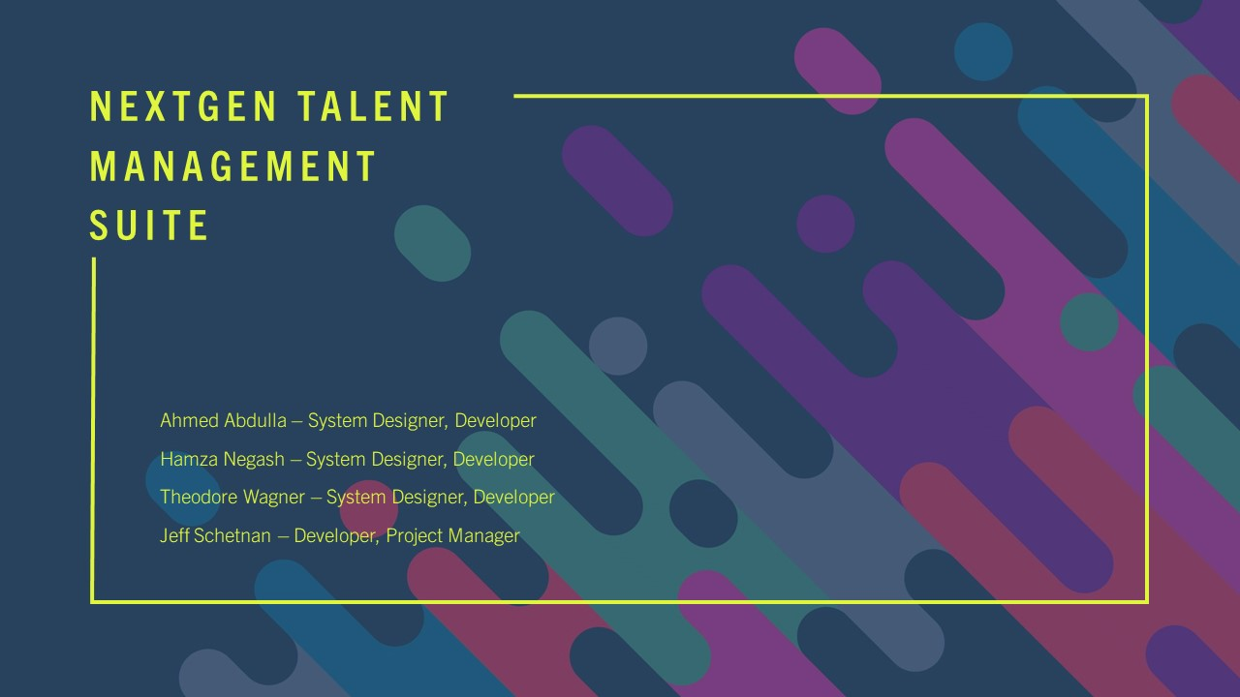

Slide 2
Project Overview
Description: This project saw the development of a comprehensive application allowing managers and supervisors in any organization to manage their employees effectively and with ease.

Slide 3
Main Requirements
Project Requirements
Business Profile | SWOT Analysis
Requirement gathering | Development timeline
Business Process Flow Diagram | Functional Decomposition Diagram
Field requirements documentation | Effective UI design
Software Requirements & Functions
Easy to use, simple to understand | Main (home) screen
Add employee (onboarding) function | Remove employee (offboarding) function
Employee lookup function | Clearance & certification update function
Employee promotion function | Overtime & PTO approve/reject function

Slide 4
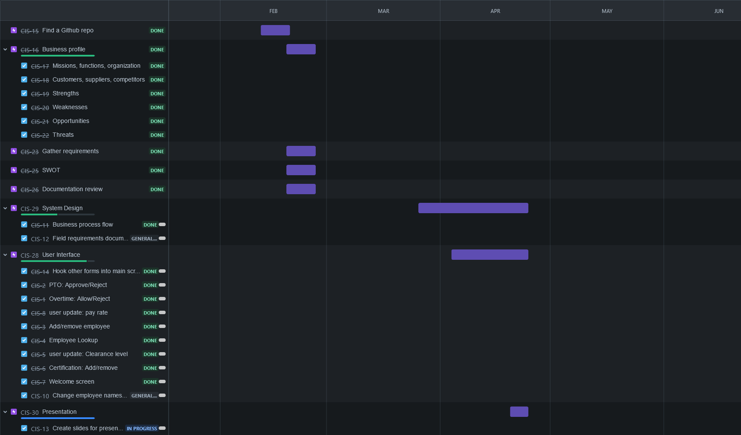
Work Breakdown Structure

Slide 5
Feasibility Analysis (SWOT)
Strengths | Weaknesses
Open source allows for fast development and improvement. Also allows for community support of the product Easy to deploy and use for a small business Being a minimal application, it’s an easy application to build on top of to add new features Would require minimal training for employees to use Uses a popular framework (Django) Free to use Uses Python, a very popular language, so no new languages will need to be learned to use, update, add features to, or understand the program | Being a minimal application, any specific features or functions that we’d need don’t come with it, and we’ll have to build it ourselves Scaling would be difficult for this program, should the company grow significantly in size No user interface Uses Python, a relatively slow language
Opportunities | Threats
Would be able to integrate other tools or applications with this easily, due to its simplicity Can easily add features on top of small-small-hr instead of building an HR management system from the ground up, or paying for one that has the features we need Can customize the program to operate exactly as needed to meet project requirements | Hasn’t been updated in 2 years There may be other HR software programs that are already built with features we may need to include down the road Adding features to it may hinder the effectiveness of the program, and have to wait longer to benefit from using it May not be the most secure

Slide 6
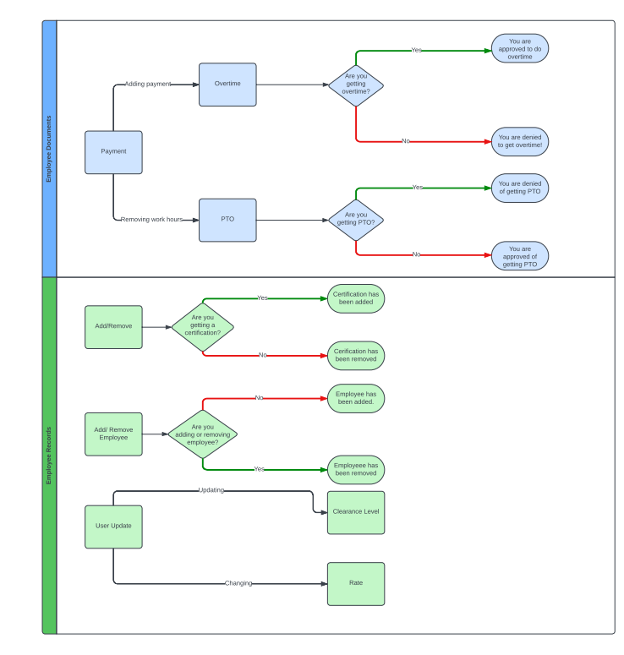
System Design: Business Process Flow
Employee Documents
Employee Records

Slide 7
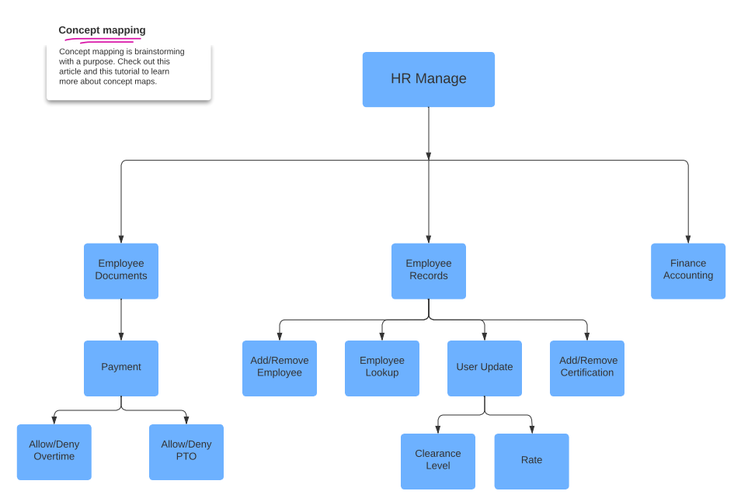

System Design: Functional Decomposition Diagram

Slide 8
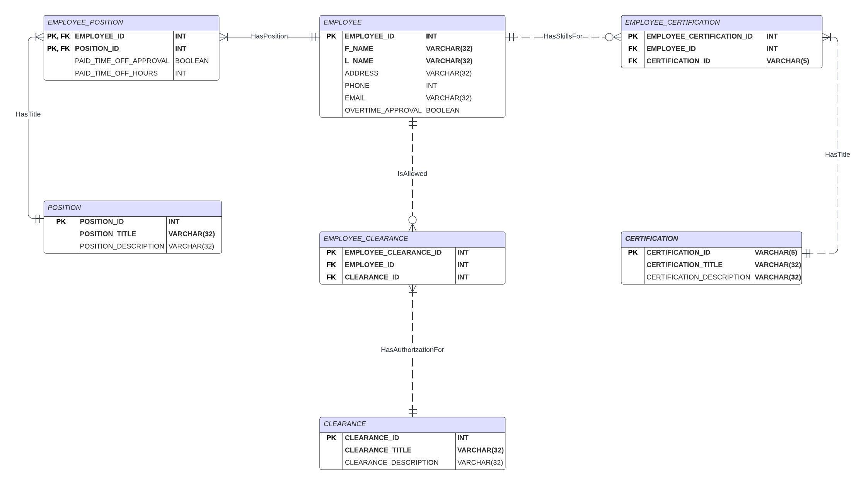
System Design: Entity Relationship Diagram

Slide 9
User Interface Demonstration

